Slide 1
Chapter 8: Relational Database Design- Functional Dependencies
Notes:
1

Slide 2
Chapter 8: Relational Database Design
Features of Good Relational Design
Atomic Domains and First Normal Form
Decomposition Using Functional Dependencies
Functional Dependency Theory
Algorithms for Functional Dependencies
Decomposition Using Multivalued Dependencies
More Normal Form
Database-Design Process
Modeling Temporal Data
Notes:
2

Slide 3
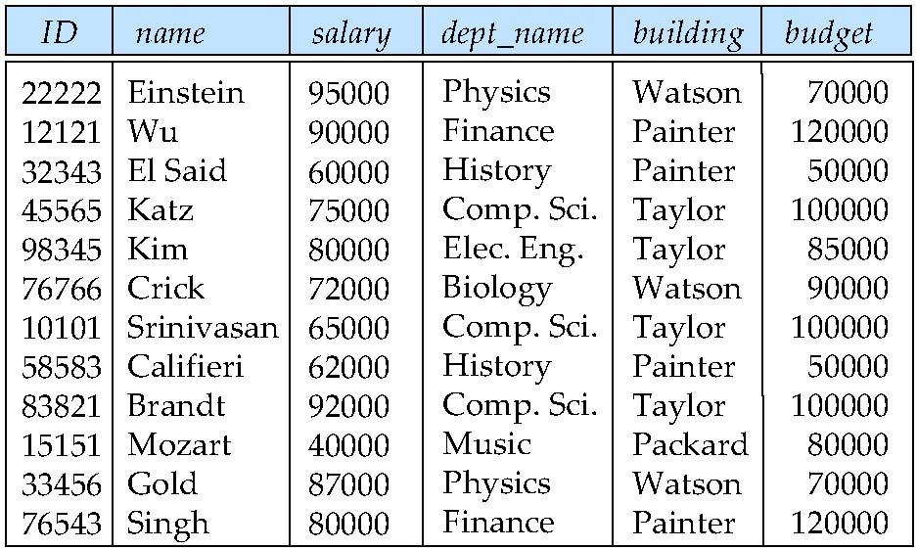
Combine Schemas?
Suppose we combine instructor and department into inst_dept
(No connection to relationship set inst_dept)
Such a design where there is too much redundancy in the database's information can cause data anomalies. Anomalies can often be caused when the tables that make up the database suffer from bad design.
Notes:
3

Slide 4
There are three types of Data Anomalies: Update Anomalies, Insertion Anomalies, and Deletion Anomalies.
Update Anomalies: Some data may have to be changed, which could involve many records having to be changed, leading to the possibility of some changes being made incorrectly.
Example: If we want to change the budget of a particular department, It is important that all the tuples agree as to the budget amount since otherwise our database would be inconsistent.
In our original design using instructor and department, we stored the amount of each budget exactly once. This suggests that using in_dep is a bad idea since it stores the budget amounts redundantly and runs the risk that some user might update the budget amount in one tuple but not all, and thus create inconsistency.

Slide 5
Insertion Anomalies: It happens when inserting vital data into the database is not possible because other data is not already there.
Example: Suppose we are creating a new department in the university. In the alternative design above, we cannot represent directly the information concerning a department (dept name, building, budget) unless that department has at least one instructor at the university.
This is because tuples in the in_dep table require values for ID, name, and salary. This means that we cannot record information about the newly created department until the first instructor is hired for the new department.

Slide 6
Deletion Anomalies: It happens when the deletion of unwanted information causes desired information to be deleted as well.
Example: Suppose we want to delete the record for instructor Mozart. Then we will also delete the record for the Music department which we don’t desire to do.

Slide 7
A Combined Schema Without Repetition
Consider combining relations
sec_class(sec_id, building, room_number) and
section(course_id, sec_id, semester, year)
into one relation
section(course_id, sec_id, semester, year, building, room_number)
No repetition in this case
Notes:
7

Slide 8
Decomposition
The only way to avoid the repetition-of-information problem in the in_dep schema is to decompose it into two schemas – instructor and department schemas.
Not all decompositions are good. Suppose we decompose
employee(ID, name, street, city, salary)
into
employee1 (ID, name)
employee2 (name, street, city, salary)
The problem arises when we have two employees with the same name
The next slide shows how we lose information -- we cannot reconstruct the original employee relation -- and so, this is a lossy decomposition.

Slide 9
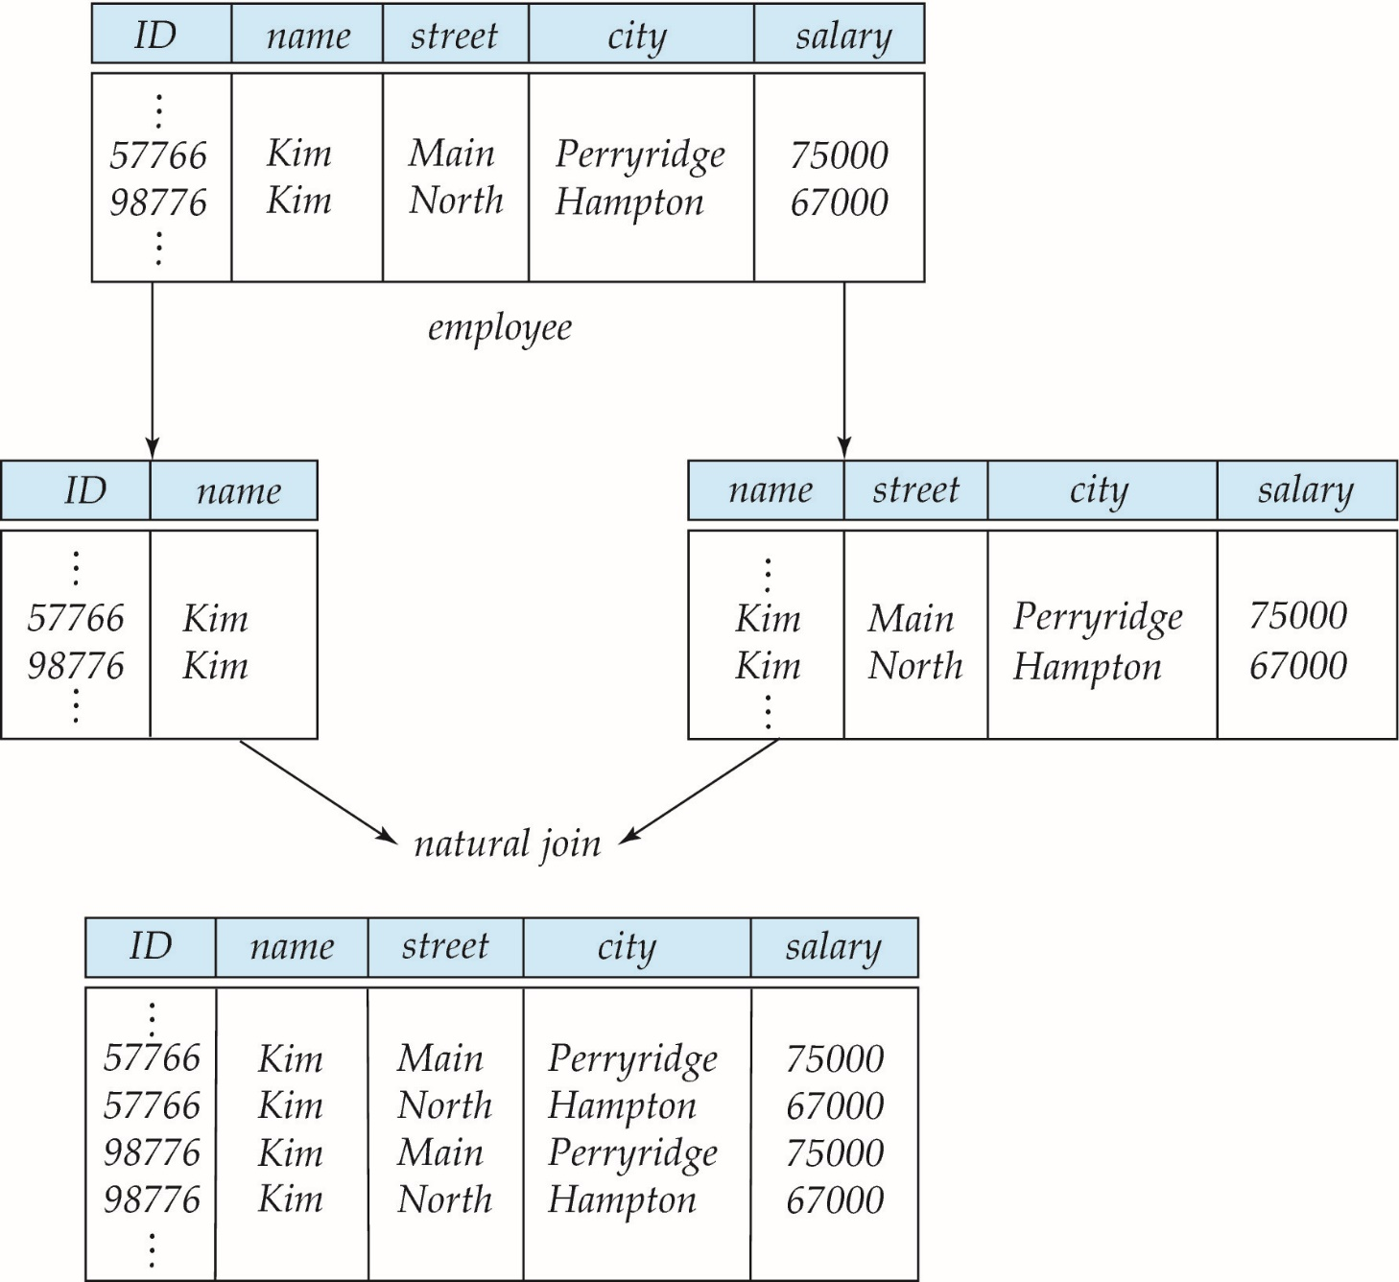
A Lossy Decomposition
Notes:
9

Slide 10
Lossless Decomposition
Let R be a relation schema and let R₁ and R₂ form a decomposition of R . That is R = R₁ U R₂
We say that the decomposition is a lossless decomposition if there is no loss of information by replacing R with the two relation schemas R₁ U R₂
Formally,
∏ _{R1} (r) ∏ _{R2} (r) = r
And, conversely a decomposition is lossy if
r ⊂ ∏ _{R1} (r) ∏ _{R2} (r) = r

Slide 11
Example of Lossless-Join Decomposition
Lossless join decomposition
Decomposition of R = (A, B, C) R₁ = (A, B) R₂ = (B, C)
A
B
C
A
B
B
C
α
β
1
2
A
B
α
β
1
2
1
2
A
B
r
∏_{A,B}(r)
∏_{B,C}(r)
∏_{A} (r) ∏_{B} (r)
A
B
C
α
β
1
2
A
B
Notes:
11

Slide 12
Goal — Devise a Theory for the Following
Decide whether a particular relation R is in “good” form.
In the case that a relation R is not in “good” form, decompose it into a set of relations {R₁, R₂, ..., R_{n}} such that
each relation is in good form
the decomposition is a lossless-join decomposition
Our theory is based on:
functional dependencies
multivalued dependencies
Notes:
12

Slide 13
Functional Dependencies
There are usually a variety of constraints (rules) on the data in the real world.
For example, some of the constraints that are expected to hold in a university database are:
Students and instructors are uniquely identified by their ID.
Each student and instructor has only one name.
Each instructor and student is (primarily) associated with only one department.
Each department has only one value for its budget, and only one associated building.

Slide 14
Functional Dependencies (Cont.)
An instance of a relation that satisfies all such real-world constraints is called a legal instance of the relation;
A legal instance of a database is one where all the relation instances are legal instances
Constraints on the set of legal relations.
Require that the value for a certain set of attributes determines uniquely the value for another set of attributes.
A functional dependency is a generalization of the notion of a key.

Slide 15
Functional Dependencies (Cont.)
Let R be a relation schema
α ⊆ R and β ⊆ R
The functional dependency
α → β holds on R if and only if for any legal relations r(R), whenever any two tuples t₁ and t₂ of r agree on the attributes α, they also agree on the attributes β. That is,
t₁[α] = t₂ [α] ⇒ t₁[β ] = t₂ [β ]
Example: Consider r(A,B ) with the following instance of r.
On this instance, A → B does NOT hold, but B → A does hold.
4
1 5
3 7
Notes:
15

Slide 16
Functional Dependencies (Cont.)
K is a superkey for relation schema R if and only if K → R
K is a candidate key for R if and only if
K → R, and
for no α ⊂ K, α → R
Functional dependencies allow us to express constraints that cannot be expressed using superkeys. Consider the schema:
inst_dept (ID, name, salary, dept_name, building, budget ).
We expect these functional dependencies to hold:
dept_name→ building
and ID -> building
but would not expect the following to hold:
dept_name → salary
Notes:
16

Slide 17
Use of Functional Dependencies
We use functional dependencies to:
test relations to see if they are legal under a given set of functional dependencies.
If a relation r is legal under a set F of functional dependencies, we say that r satisfies F.
specify constraints on the set of legal relations
We say that F holds on R if all legal relations on R satisfy the set of functional dependencies F.
Note: A specific instance of a relation schema may satisfy a functional dependency even if the functional dependency does not hold on all legal instances.
For example, a specific instance of instructor may, by chance, satisfy name → ID.
Notes:
17

Slide 18
Functional Dependencies (Cont.)
A functional dependency is trivial if it is satisfied by all relations.
Example: A→A is satisfied by all relations involving attribute A.
In general, α → β is trivial if β ⊆ α
Example:
ID, name → ID
name → name
Notes:
18

Slide 19
Closure of a Set of Functional Dependencies
Given a set F of functional dependencies, there are certain other functional dependencies that are logically implied by F.
For example: If A → B and B → C, then we can infer that A → C
The set of all functional dependencies logically implied by F is the closure of F.
We denote the closure of F by F⁺.
F⁺ is a superset of F.
Notes:
19

Slide 20
Closure of a Set of Functional Dependencies
We can find F^{+,} the closure of F, by repeatedly applying Armstrong’s Axioms:
if β ⊆ α, then α → β (reflexivity)
if α → β, then γ α → γ β (augmentation)
if α → β, and β → γ, then α → γ (transitivity)
These rules are
sound (generate only functional dependencies that actually hold), and
complete (generate all functional dependencies that hold).
Notes:
20

Slide 21
Example
R = (A, B, C, G, H, I) F = { A → B A → C CG → H CG → I B → H}
some members of F⁺
A → H
by transitivity from A → B and B → H
AG → I
by augmenting A → C with G, to get AG → CG and then transitivity with CG → I
CG → HI
by augmenting CG → I to infer CG → CGI,
and augmenting of CG → H to infer CGI → HI,
and then transitivity
Notes:
21

Slide 22
Procedure for Computing F⁺
To compute the closure of a set of functional dependencies F:
F ⁺ = F repeat for each functional dependency f in F⁺ apply reflexivity and augmentation rules on f add the resulting functional dependencies to F ⁺ for each pair of functional dependencies f₁and f₂ in F ⁺ if f₁ and f₂ can be combined using transitivity then add the resulting functional dependency to F ⁺ until F ⁺ does not change any further
NOTE: We shall see an alternative procedure for this task later
Notes:
22

Slide 23
Closure of Functional Dependencies (Cont.)
Additional rules:
If α → β holds and α → γ holds, then α → β γ holds (union)
If α → β γ holds, then α → β holds and α → γ holds (decomposition)
If α → β holds and γ β → δ holds, then α γ → δ holds (pseudotransitivity)
The above rules can be inferred from Armstrong’s axioms.
Notes:
23

Slide 24
Closure of Attribute Sets
Given a set of attributes α, define the closure of α under F (denoted by α⁺) as the set of attributes that are functionally determined by α under F
Algorithm to compute α⁺, the closure of α under F
result := α; while (changes to result) do for each β → γ in F do begin if β ⊆ result then result := result ∪ γ end
Notes:
24

Slide 25
Example of Attribute Set Closure
R = (A, B, C, G, H, I)
F = {A → B A → C CG → H CG → I B → H}
(AG)⁺
1. result = AG
2. result = ABCG (A → C and A → B)
3. result = ABCGH (CG → H and CG ⊆ AGBC)
4. result = ABCGHI (CG → I and CG ⊆ AGBCH)
Is AG a candidate key?
Is AG a super key?
Does AG → R? == Is (AG)⁺ ⊇ R
Is any subset of AG a superkey?
Does A → R? == Is (A)⁺ ⊇ R
Does G → R? == Is (G)⁺ ⊇ R
Notes:
25

Slide 26
Uses of Attribute Closure
There are several uses of the attribute closure algorithm:
Testing for superkey:
To test if α is a superkey, we compute α^{+,} and check if α⁺ contains all attributes of R.
Testing functional dependencies
To check if a functional dependency α → β holds (or, in other words, is in F⁺), just check if β ⊆ α⁺.
That is, we compute α⁺ by using attribute closure, and then check if it contains β.
Is a simple and cheap test, and very useful
Computing closure of F
For each γ ⊆ R, we find the closure γ⁺, and for each S ⊆ γ⁺, we output a functional dependency γ → S.
Notes:
26

